Slide 1
Strand 2: Unit 1
What’s in food?

Slide 2
Carbohydrates
Most foods contain carbohydrates, which the body breaks down into simple sugars – the major source of energy for the body.

Slide 3
Carbohydrates
The main foods in this group are grains, wheat and rice. They also contain fibre, which helps digestion and makes you feel full.

Slide 4
Proteins
Many foods contain protein, but the best sources are red meat, poultry, fish, eggs, dairy products, nuts, seeds and pulses like black beans and lentils.

Slide 5
Proteins
Protein builds, maintains and replaces the tissues in your body. Many foods high in protein also contain minerals our bodies need to stay healthy.

Slide 6
Proteins
For example, red meat contains iron, which the body needs to make blood.

Slide 7
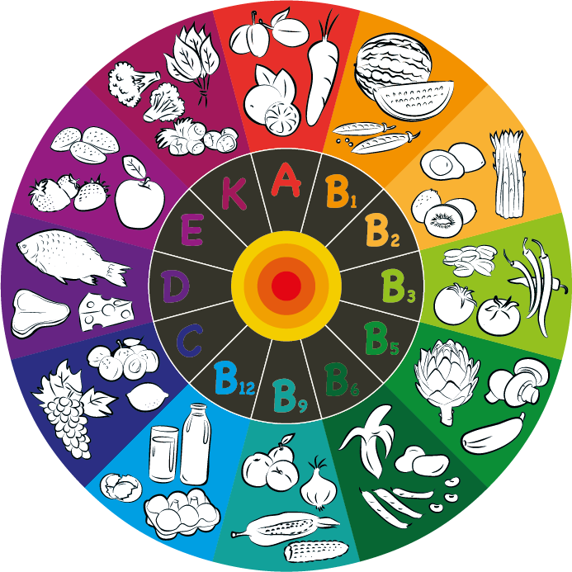
Vitamins
Vitamins and minerals are substances found in foods we eat. Your body needs them to work properly, so you grow and develop as you should. Each vitamin has a special role to play.

Slide 8
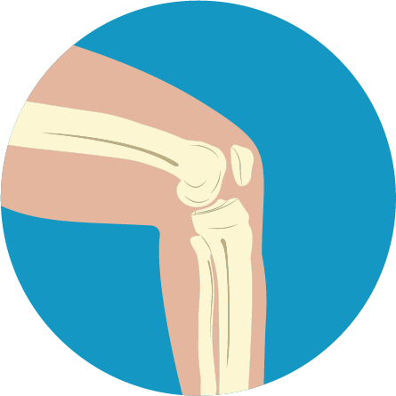
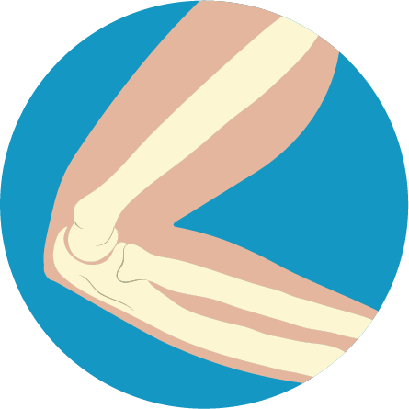
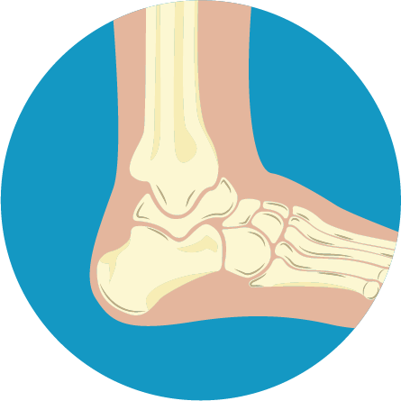
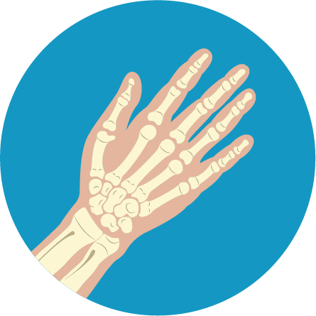
Vitamins
For example:
Vitamin D in milk helps your bones

Slide 9
Vitamins
For example:
Vitamin A in carrots helps you see at night

Slide 10
Vitamins
For example:
Vitamin C in oranges helps your body heal if you get a cut

Slide 11
Vitamins
For example:
B vitamins in leafy green vegetables help your body make protein and energy

Slide 12
Minerals
The body uses minerals to perform many different functions – from building strong bones to transmitting nerve impulses.

Slide 13
Minerals
Just like vitamins, minerals help your body grow, develop, and stay healthy.

Slide 14
Minerals
Some minerals are even used to make hormones or maintain a normal heartbeat.

Slide 15
Fats
Fat is an important part of a healthy diet, but only in small amounts. It provides energy, keeps us warm and helps us to absorb certain vitamins.

Slide 16
Fats
Fat is a component in food. Some foods, including most fruits and vegetables, have almost no fat. Other foods have plenty of fat. They include nuts, oils, butter and meats like beef.

Slide 17
Fats
Young children need a certain amount of fat in their diets so the brain and nervous system develop correctly. That's why toddlers need to drink whole milk, which has more fat, and older children can drink low-fat or skimmed milk.

Slide 18
Water
Drink water regularly: we need at least eight cups of fluid per day.

Slide 19
Water
Fluid losses occur continuously, from skin evaporation, breathing, and urine, and these losses must be replaced daily for good health.

Slide 20
Water
When your water intake does not equal your output, you can become dehydrated. Fluid losses are greater in warmer climates, during strenuous exercise and
at high altitudes.

